Slide 1
Chapter 10
More skills for working with Windows forms and controls

Slide 2
Objectives (part 1)
Applied
Given the specifications for a form that uses any of the controls presented in this chapter, design and code the form.
Given a form with two or more controls, set the tab order of the controls using the Tab Order view of the form.
Given the specifications for an application that displays custom or standard dialog boxes, design and code the application.
Knowledge
In general terms, describe the use of these controls: combo box, list box, radio button, check box, and group box.
Explain how the refactoring feature helps you change some of the occurrences of the form name in the code when you rename the file for the form, but not the occurrences in the event handlers for the form.

Slide 3
Objectives (part 2)
Describe the way the Program class for an application displays the first form of an application.
Describe how you can use the DialogResult enumeration and the Tag property to pass data between a form and a custom dialog box.
Describe how you can use the FormClosing event to stop a form from closing.

Slide 4
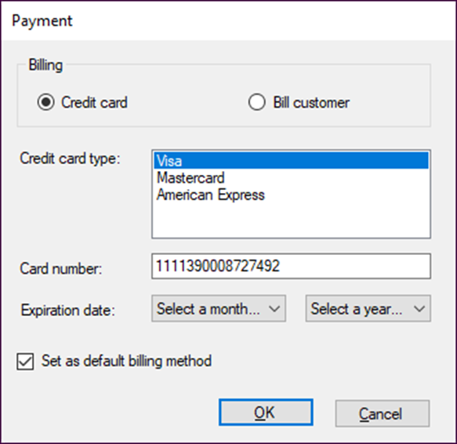
A form with five more types of controls

Slide 5
Common properties of list box and combo box controls
SelectedIndex
SelectedItem
Text
Sorted
Items
DropDownStyle
SelectionMode
Common events of list box and combo box controls
SelectedIndexChanged
TextChanged

Slide 6
Common properties of the Items collection
[index]
Count
Common methods of the Items collection
Add(object)
Insert(index, object)
Remove(object)
RemoveAt(index)
Clear()

Slide 7
Code that loads a combo box with months
string[] months =
{"Select a month...",
"January", "February", "March", "April",
"May", "June", "July", "August",
"September", "October", "November", "December"};
foreach (string month in months)
{
cboExpirationMonth.Items.Add(month);
}

Slide 8
Code that loads a combo box with years
int year = DateTime.Today.Year;
int endYear = year + 8;
cboExpirationYear.Items.Add("Select a year...");
while (year < endYear)
{
cboExpirationYear.Items.Add(year);
year++;
}

Slide 9
Code that clears and loads a list box of credit cards
lstCreditCardType.Items.Clear();
lstCreditCardType.Items.Add("Visa");
lstCreditCardType.Items.Add("Mastercard");
lstCreditCardType.Items.Add("American Express");
lstCreditCardType.SelectedIndex = 0; // select first item
Statements that get information from a combo box or list box
int expYearIndex = cboExpirationYear.SelectedIndex;
string expYearText = cboExpirationYear.Text;
int expYearValue = (int) cboExpirationYear.SelectedItem;
string expMonthValue =
cboExpirationMonth.Items[1].ToString();

Slide 10
Code that works with a combo box of names
string[] names = {"Judy Taylor", "Anne Boehm", "Kelly Slivkoff"};
foreach (string name in names)
{
cboNames.Items.Add(name);
}
cboNames.Items.Insert(0, "Joel Murach");
cboNames.Items.RemoveAt(3);
cboNames.SelectedIndex = -1; // don't select an item

Slide 11
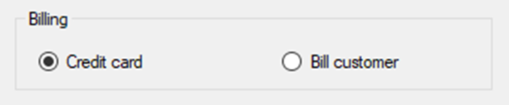
A group box that contains two radio buttons
Common property of radio button and check box controls
Checked
Common event of radio button and check box controls
CheckedChanged

Slide 12
Code that sets the value of a radio button and check box
rdoCreditCard.Checked = true;
chkDefault.Checked = true;
Code that checks the value of a radio button
private void rdoCreditCard_CheckedChanged(object sender, EventArgs e)
{
if (rdoCreditCard.Checked == true)
EnableControls();
else
DisableControls();
}
Code that gets the value of a check box
bool isDefaultBilling = chkDefault.Checked;

Slide 13
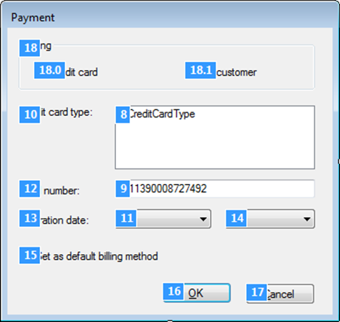
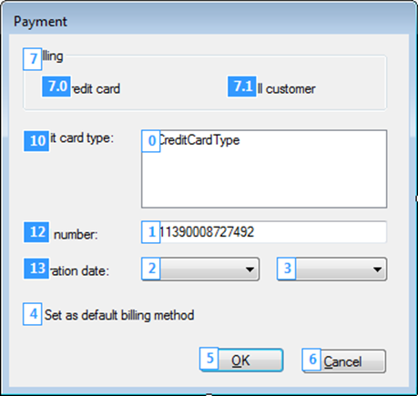
A form in Tab Order view before and after the tab order is changed

Slide 14
How to use Tab Order view (part 1)
To display a form in Tab Order view, select it and then select the View→Tab Order command. This displays the tab index for each control as in the first form above.
If the form isn’t displayed in Tab Order view, display the Options dialog box (Tools→Options), select the General category in the Environment group, and uncheck the Optimize Rendering for Screens with Different Pixel Densities option.
To change the tab indexes of the controls, click on the controls in the sequence you want to use. As you click, the new tab indexes appear.
The first time you click on a control in Tab Order view, the tab index is set to the next number in sequence, starting with zero for the first control. If you click on the same control more than once, the tab index is increased by one each time you click.

Slide 15
How to use Tab Order view (part 2)
The controls in a group box are displayed with sub indexes. Then, you can click on the group box to change its index and the main indexes of the controls it contains. To change the sub indexes of the controls in the group box, click on them individually.

Slide 16
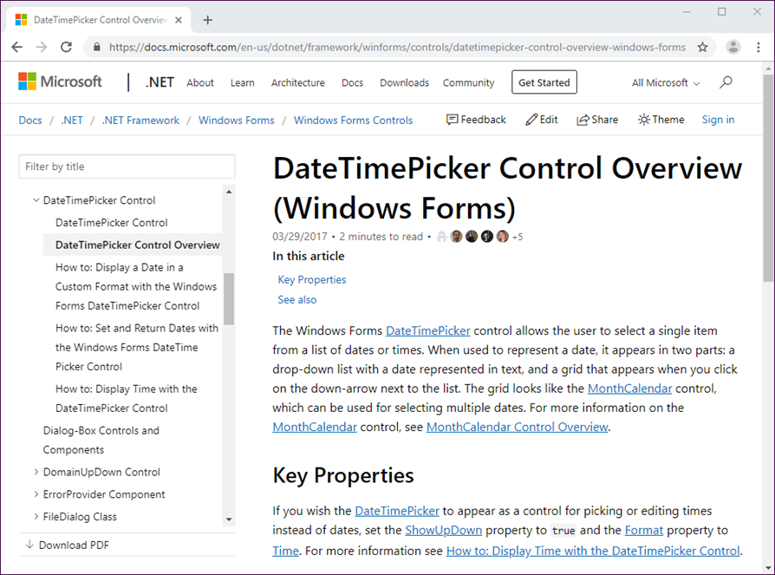
The web address for getting help for controls
https://docs.microsoft.com/en-us/dotnet/framework/winforms/controls/
Help for the DateTimePicker control

Slide 17
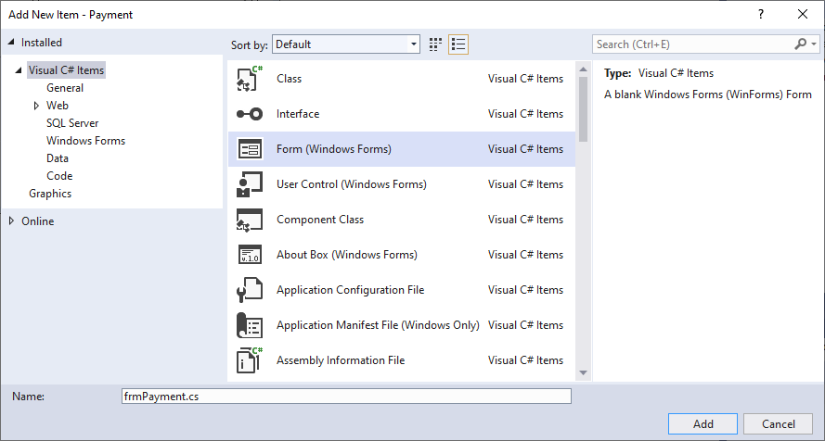
The Add New Item dialog box

Slide 18
How to add a new form
Display the Add New Item dialog box by selecting the Project→Add New Item command. Or, select the Add→New Item command from the shortcut menu that’s displayed when you right-click on the project in the Solution Explorer.
To add a new form, select the Form (Windows Forms) template from the Add New Item dialog box, enter a name for the form, and click the Add button.

Slide 19
How to add an existing form
Display the Add Existing Item dialog box by selecting the Project→Add Existing Item command. Or, select the Add→Existing Item command from the shortcut menu for the project.
To add an existing form, select the cs file for the form from the Add Existing Item dialog box and then click the Add button.
If the form is in a different namespace than the other forms in the project, you will need to either change the namespace for the form or add a using directive for the namespace to each form that refers to it.
To change the namespace for a form, display the code for the form and then change the name on the namespace statement near the top of the code using refactoring.

Slide 20
The generated code for a new form named frmPayment (part 1)
For the frmPayment.cs file
namespace Payment
{
public partial class frmPayment : Form
{
public frmPayment()
{
InitializeComponent();
}
}
}

Slide 21
The generated code for a new form named frmPayment (part 2)
For the frmPayment.Designer.cs file
namespace Payment
{
partial class frmPayment
{
private System.ComponentModel.IContainer components =
null;
protected override void Dispose(bool disposing)
{
if (disposing && (components != null))
{
components.Dispose();
}
base.Dispose(disposing);
}
#region Windows Form Designer generated code
}
}

Slide 22
The code that’s generated for the Load event handler of the form
The method declaration in the frmPayment.cs file
private void frmPayment_Load(object sender, EventArgs e)
{
// code that handles the event goes here
}
The wiring in the frmPayment.Designer.cs file
this.Load += new System.EventHandler(this.frmPayment_Load);

Slide 23
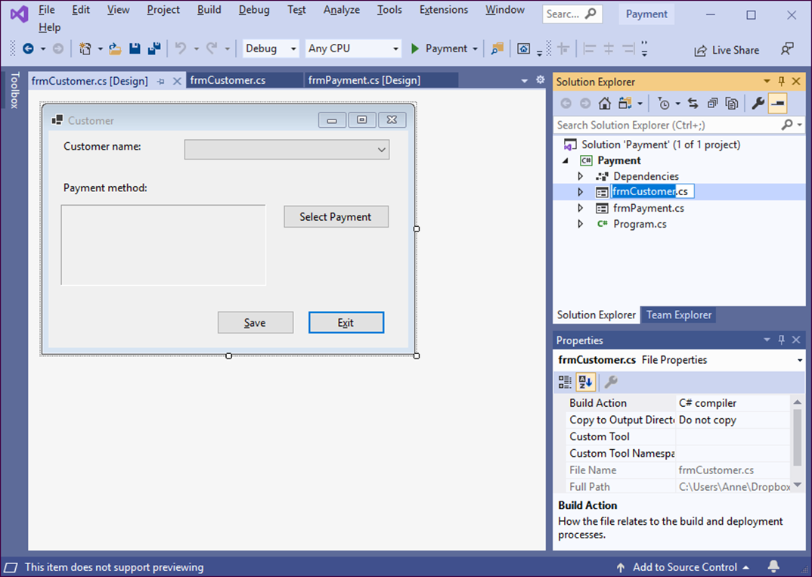
A project that contains two forms

Slide 24
How to change the name of a form
Right-click the form in the Solution Explorer and select the Rename command. Or, select the form in the Solution Explorer and press F2.
Enter the new name for the form. When you do, Visual Studio asks if you want to rename all references to the file. In most cases, that’s what you’ll want to do.
How to change the name of any event handlers for a form’s events
Highlight the name of the form in the method that’s used by the event handler, then right-click on the name and choose Rename from the shortcut menu that’s displayed.
Enter the new name for the form and click the Apply button in the Rename dialog box.

Slide 25
Code that defines the main entry point for an application
using System;
using System.Collections.Generic;
using System.Linq;
using System.Threading.Tasks;
using System.Windows.Forms;
namespace Payment
{
static class Program
{
/// <summary>
/// The main entry point for the application.
/// </summary>
[STAThread]
static void Main()
{
Application.EnableVisualStyles();
Application.SetCompatibleTextRenderingDefault(false);
Application.Run(new frmCustomer());
}
}
}

Slide 26
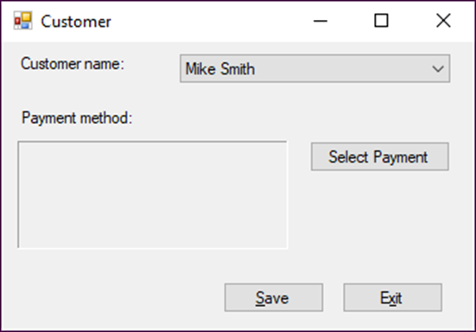
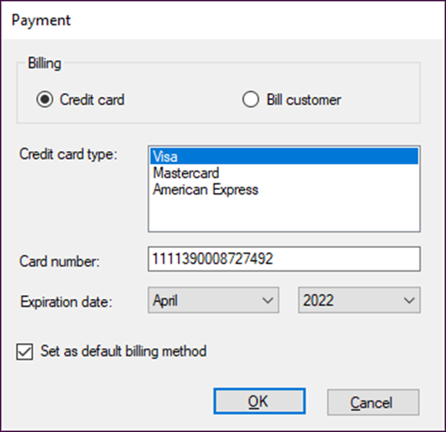
The Payment form displayed as a dialog box

Slide 27
Properties for creating custom dialog boxes
FormBorderStyle
ControlBox
MaximizeBox
MinimizeBox

Slide 28
Code that creates and displays a custom dialog box
Form paymentForm = new frmPayment();
paymentForm.ShowDialog();
// execution continues here after the user responds
// to the dialog box

Slide 29
An enumeration that works with dialog boxes
Enumeration Members
DialogResult OK, Cancel, Yes, No, Abort, Retry, Ignore, None
The Tag property
Property Description
Tag Gets or sets data associated with the form or a control. The Tag property holds a reference to an object type, which means that it can hold any type of data.

Slide 30
A statement that sets the DialogResult property of a form
this.DialogResult = DialogResult.OK;
A statement that sets the Tag property of a form
this.Tag = msg;
Code that uses the result of a dialog box and the Tag property
Form paymentForm = new frmPayment();
DialogResult selectedButton = paymentForm.ShowDialog();
if (selectedButton == DialogResult.OK)
lblPayment.Text = paymentForm.Tag.ToString();

Slide 31
How to use the DialogResult enumeration
The DialogResult enumeration provides members that represent the values that a dialog box can return. The ShowDialog() method returns a member of this enumeration.
You specify the result value of a custom dialog box by setting its DialogResult property. Or, you can set the DialogResult property of a button in the dialog box. Then, when the user clicks that button, the DialogResult property of the form is set accordingly.
If you set the CancelButton property of a form to a button on that form, the DialogResult property of that button is automatically set to Cancel.
After you set the DialogResult property of a dialog box, the form is closed and control is returned to the form that displayed it. If you close a dialog box without setting the DialogResult property, a value of Cancel is returned to the main form.

Slide 32
How to use the Tag property
The Tag property provides a convenient way to pass data between forms in a multi-form application.
A dialog box can set its Tag property before it returns control to the main form. Then, the main form can get the data from this property and use it as necessary.
Because the Tag property is an object type, you must explicitly cast it to the appropriate type to retrieve the data it contains. Or, you can use the ToString() method to convert the data to a string.

Slide 33
The syntax for the Show() method of the MessageBox class
MessageBox.Show(text[, caption[, buttons[, icon
[, defaultButton]]]]);
The enumerations that work with the MessageBox class
Enumeration Members
MessageBoxButtons OK, OKCancel, YesNo, YesNoCancel, AbortRetryIgnore
MessageBoxIcon None, Information, Error, Warning, Exclamation, Question, Asterisk, Hand, Stop
MessageBoxDefaultButton Button1, Button2, Button3
DialogResult OK, Cancel, Yes, No, Abort, Retry, Ignore

Slide 34
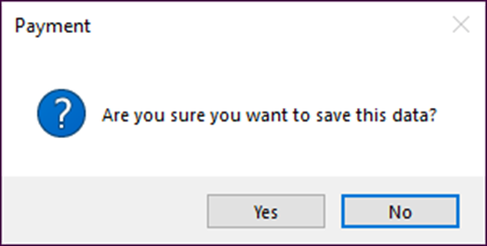
A statement that displays a dialog box and gets the user response
DialogResult button =
MessageBox.Show(
"Are you sure you want to save this data?",
"Payment",
MessageBoxButtons.YesNo,
MessageBoxIcon.Question,
MessageBoxDefaultButton.Button2);
The dialog box that’s displayed

Slide 35
A statement that checks the user response
if (button == DialogResult.Yes)
{
SaveData();
isDataSaved = true;
}

Slide 36
The code for a dialog box that cancels the Closing event
private void frmCustomer_FormClosing(object sender, FormClosingEventArgs e)
{
if (isDataSaved == false)
{
string message =
"This form contains unsaved data.\n\n" +
"Do you want to save it?";
DialogResult button =
MessageBox.Show(message, "Customer",
MessageBoxButtons.YesNoCancel,
MessageBoxIcon.Warning);
if (button == DialogResult.Yes)
{
if (IsValidData())
this.SaveData();
else
e.Cancel = true;
}
if (button == DialogResult.Cancel)
{
e.Cancel = true;
}
}
}

Slide 37
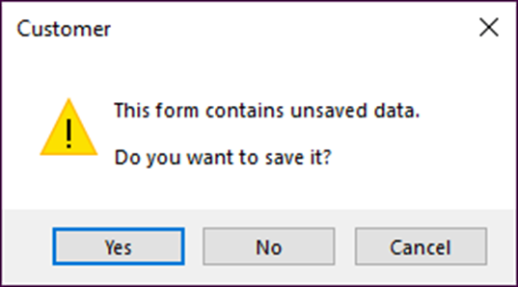
The dialog box that’s displayed

Slide 38
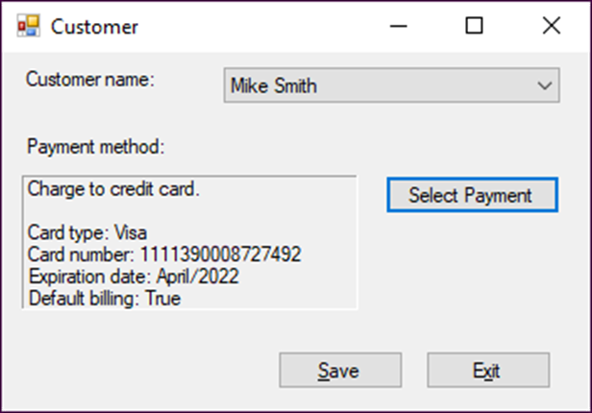
The Customer form

Slide 39
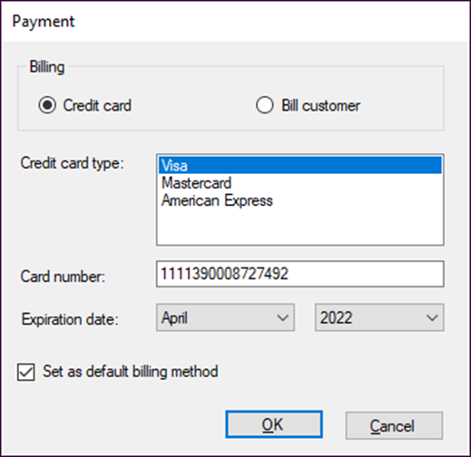
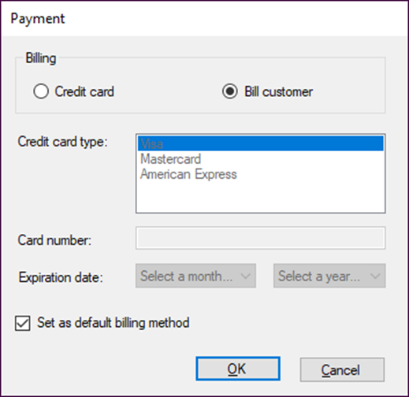
Two versions of the Payment dialog box

Slide 40
Property settings for the Customer form
Default name Property Setting
Form1 Name frmCustomer Text Customer CancelButton btnExit StartPosition CenterScreen
comboBox1 Name cboNames DropDownStyle DropDownList
label3 Name lblPayment BorderStyle Fixed3D AutoSize False Text ""
button1 Name btnSave
button2 Name btnExit
Button3 Name btnSelectPayment

Slide 41
Property settings for the Payment form (part 1)
Default name Property Setting
Form2 Name frmPayment Text Payment AcceptButton btnOK CancelButton btnCancel StartPosition CenterScreen ControlBox False MaximizeBox False FormBorderStyle FixedDialog
groupBox1 Text Billing
radioButton1 Name rdoCreditCard Checked True
radioButton2 Name rdoBillCustomer
listBox1 Name lstCreditCardType
textBox1 Name txtCardNumber

Slide 42
Property settings for the Payment form (part 2)
Default name Property Setting
comboBox1 Name cboExpirationMonth DropDownStyle DropDownList
comboBox2 Name cboExpirationYear DropDownStyle DropDownList
checkBox1 Name chkDefault Checked True
button1 Name btnOK
button2 Name btnCancel DialogResult Cancel

Slide 43
The code for the Customer form (part 1)
public partial class frmCustomer : Form
{
public frmCustomer()
{
InitializeComponent();
}
bool isDataSaved = true;
private void frmCustomer_Load(object sender, EventArgs e)
{
cboNames.Items.Add("Mike Smith");
cboNames.Items.Add("Nancy Jones");
}
private void lblPayment_TextChanged(object sender, EventArgs e)
{
isDataSaved = false;
}

Slide 44
The code for the Customer form (part 2)
private void cboNames_SelectedIndexChanged(object sender,
EventArgs e)
{
isDataSaved = false;
lblPayment.Text = "";
}
private void btnSelectPayment_Click(object sender, EventArgs e)
{
Form paymentForm = new frmPayment();
DialogResult selectedButton =
paymentForm.ShowDialog();
if (selectedButton == DialogResult.OK) {
lblPayment.Text = (string) paymentForm.Tag;
}
}
private void btnSave_Click(object sender, EventArgs e)
{
if (IsValidData()) {
SaveData();
}
}

Slide 45
The code for the Customer form (part 3)
private void SaveData()
{
cboNames.SelectedIndex = -1;
lblPayment.Text = "";
isDataSaved = true;
cboNames.Focus();
}
private bool IsValidData()
{
if (cboNames.SelectedIndex == -1)
{
MessageBox.Show("You must select a customer.",
"Entry Error");
cboNames.Focus();
return false;
}
if (lblPayment.Text == "")
{
MessageBox.Show("You must enter a payment.",
"Entry Error");
return false;
}
return true;
}

Slide 46
The code for the Customer form (part 4)
private void btnExit_Click(object sender, EventArgs e)
{
this.Close();
}
private void frmCustomer_FormClosing(object sender,
FormClosingEventArgs e)
{
if (isDataSaved == false)
{
string message =
"This form contains unsaved data.\n\n" +
"Do you want to save it?";
DialogResult button =
MessageBox.Show(message, "Customer",
MessageBoxButtons.YesNoCancel,
MessageBoxIcon.Warning);

Slide 47
The code for the Customer form (part 5)
if (button == DialogResult.Yes)
{
if (IsValidData())
this.SaveData();
else
e.Cancel = true;
}
if (button == DialogResult.Cancel)
{
e.Cancel = true;
}
}
}
}

Slide 48
The code for the Payment form (part 1)
public partial class frmPayment : Form
{
public frmPayment()
{
InitializeComponent();
}
private void frmPayment_Load(object sender, EventArgs e)
{
lstCreditCardType.Items.Add("Visa");
lstCreditCardType.Items.Add("Mastercard");
lstCreditCardType.Items.Add("American Express");
lstCreditCardType.SelectedIndex = 0;
string[] months = {"Select a month...",
"January", "February", "March", "April",
"May", "June", "July", "August",
"September", "October", "November", "December"};
foreach (string month in months)
cboExpirationMonth.Items.Add(month);
cboExpirationMonth.SelectedIndex = 0;

Slide 49
The code for the Payment form (part 2)
int year = DateTime.Today.Year;
int endYear = year + 8;
cboExpirationYear.Items.Add("Select a year...");
while (year < endYear)
{
cboExpirationYear.Items.Add(year);
year++;
}
cboExpirationYear.SelectedIndex = 0;
}
private void btnOK_Click(object sender, EventArgs e)
{
if (IsValidData())
{
this.SaveData();
}
}

Slide 50
The code for the Payment form (part 3)
private bool IsValidData()
{
if (rdoCreditCard.Checked)
{
if (lstCreditCardType.SelectedIndex == -1)
{
MessageBox.Show(
"You must select a credit card type.",
"Entry Error");
lstCreditCardType.Focus();
return false;
}
if (txtCardNumber.Text == "")
{
MessageBox.Show(
"You must enter a credit card number.",
"Entry Error");
txtCardNumber.Focus();
return false;
}

Slide 51
The code for the Payment form (part 4)
if (cboExpirationMonth.SelectedIndex == 0)
{
MessageBox.Show("You must select a month.",
"Entry Error");
cboExpirationMonth.Focus();
return false;
}
if (cboExpirationYear.SelectedIndex == 0)
{
MessageBox.Show("You must select a year.",
"Entry Error");
cboExpirationYear.Focus();
return false;
}
}
return true;
}

Slide 52
The code for the Payment form (part 5)
private void SaveData()
{
string msg = null;
if (rdoCreditCard.Checked == true)
{
msg += "Charge to credit card." + "\n\n";
msg += "Card type: " + lstCreditCardType.Text + "\n";
msg += "Card number: " + txtCardNumber.Text + "\n";
msg += "Expiration date: "
+ cboExpirationMonth.Text + "/"
+ cboExpirationYear.Text + "\n";
}
else
{
msg += "Send bill to customer." + "\n\n";
}
bool isDefaultBilling = chkDefault.Checked;
msg += "Default billing: " + isDefaultBilling;
this.Tag = msg;
this.DialogResult = DialogResult.OK;
}

Slide 53
The code for the Payment form (part 6)
private void Billing_CheckedChanged(object sender, EventArgs e)
{
if (rdoCreditCard.Checked)
EnableControls();
else
DisableControls();
}
private void EnableControls()
{
lstCreditCardType.Enabled = true;
txtCardNumber.Enabled = true;
cboExpirationMonth.Enabled = true;
cboExpirationYear.Enabled = true;
}
private void DisableControls()
{
lstCreditCardType.Enabled = false;
txtCardNumber.Enabled = false;
cboExpirationMonth.Enabled = false;
cboExpirationYear.Enabled = false;
}
}

Slide 54
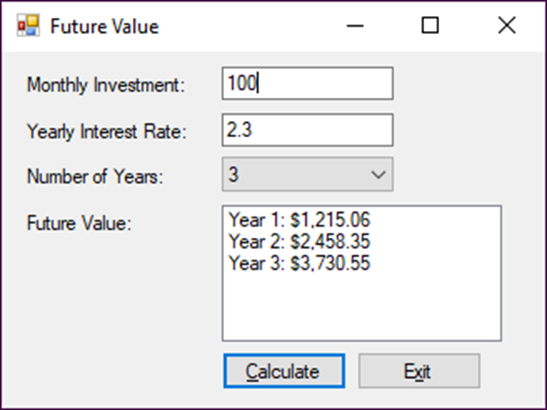
Exercise 10-2 Enhance the Future Value application
Add a combo box and a list box to the Future Value application.

Slide 55
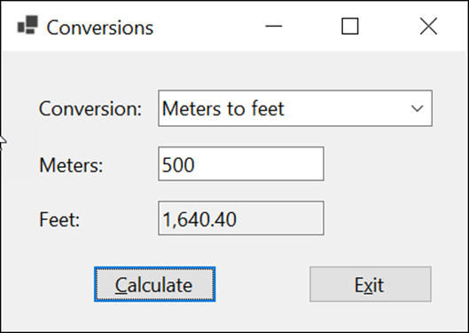
Extra 10-1 Convert lengths
Convert the value the user enters based on the selected conversion type.

Slide 56
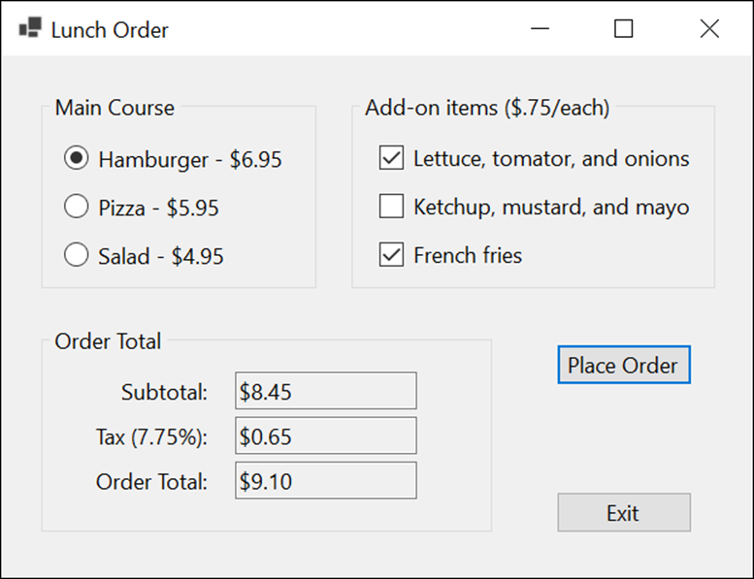
Extra 10-2 Process lunch orders
Complete a form that accepts a lunch order and then calculates the order subtotal and total.

Slide 57
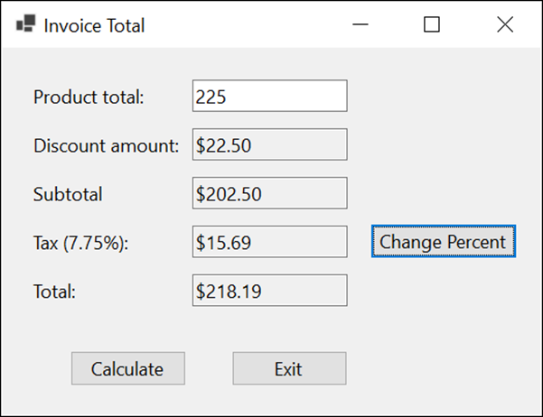
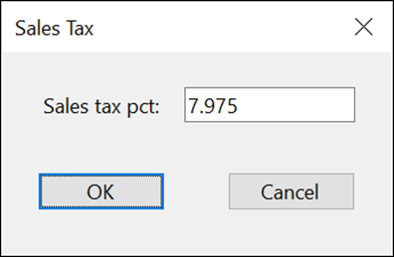
Extra 10-3 Add a second form to an Invoice Total application
Add a form to the Invoice Total application that lets the user change the sales tax percent.

Slide 58
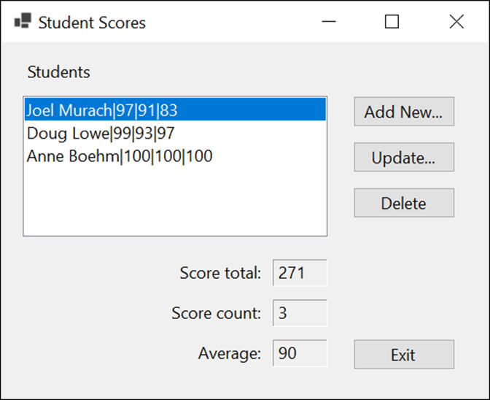
Project 2-2 Maintain student scores (part 1)
Display the score total, score count, and average for a selected student; add a new student; and update or delete a selected student.

Slide 59
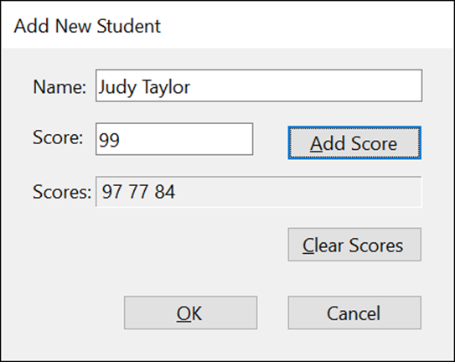
Project 2-2 Maintain student scores (part 2)
Enter a student name and zero or more scores for that student.

Slide 60
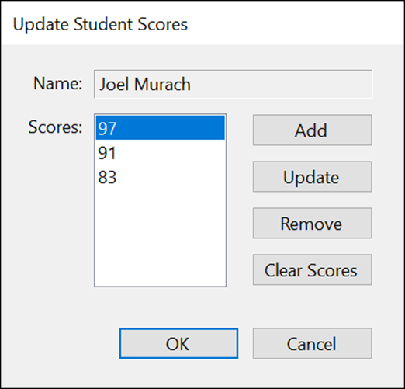
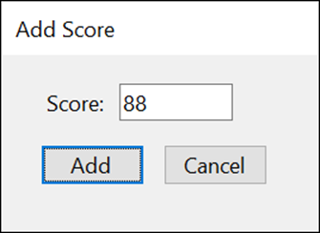
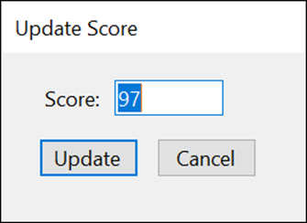
Project 2-2 Maintain student scores (part 3)
Add scores for a student, update or remove a selected score, or clear all the scores.

Slide 61
Objectives (part 1)
Applied
Given the specifications for a form that uses any of the controls presented in this chapter, design and code the form.
Given a form with two or more controls, set the tab order of the controls using the Tab Order view of the form.
Given the specifications for an application that displays custom or standard dialog boxes, design and code the application.
Knowledge
In general terms, describe the use of these controls: combo box, list box, radio button, check box, and group box.
Explain how the refactoring feature helps you change some of the occurrences of the form name in the code when you rename the file for the form, but not the occurrences in the event handlers for the form.

Slide 62
Objectives (part 2)
Describe the way the Program class for an application displays the first form of an application.
Describe how you can use the DialogResult enumeration and the Tag property to pass data between a form and a custom dialog box.
Describe how you can use the FormClosing event to stop a form from closing.

